Slide 1
Electricity Lesson 4: Series Circuits
An Introduction to Series Circuits

Slide 2
Learning Objective
To investigate current in series circuits.
Success Criteria
To recall the definition of current and the unit that is used to measure it.
To draw and construct a series circuit from a description.
To explain what happens to the current as the number of bulbs in a circuit is increased.

Slide 3

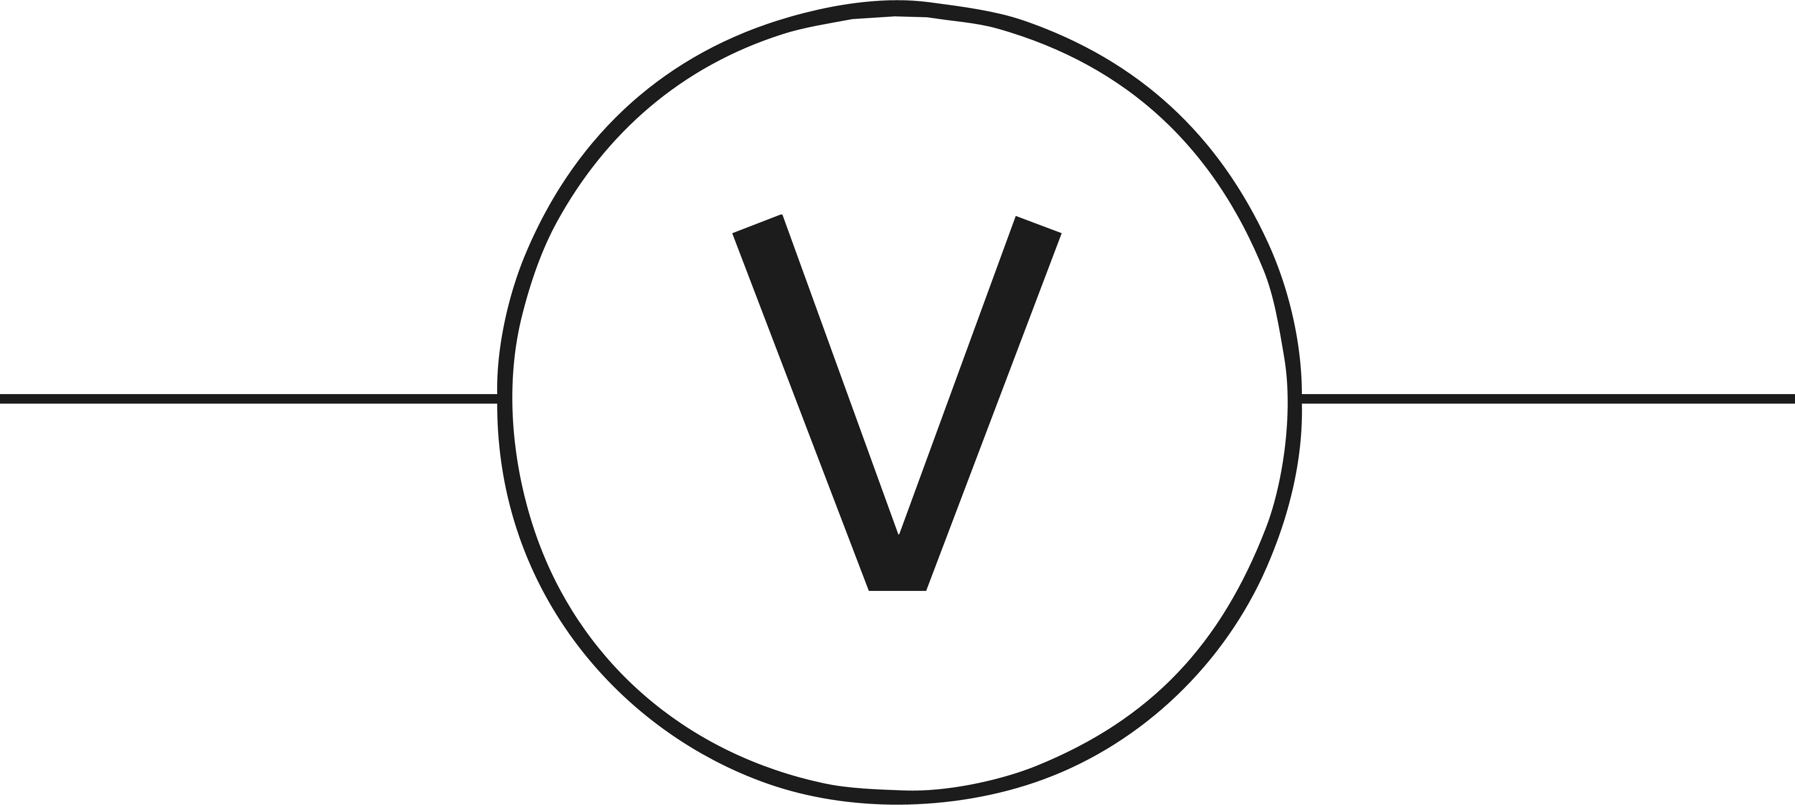
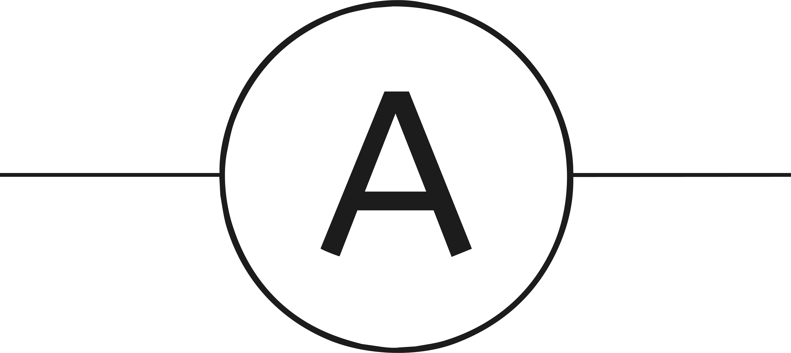
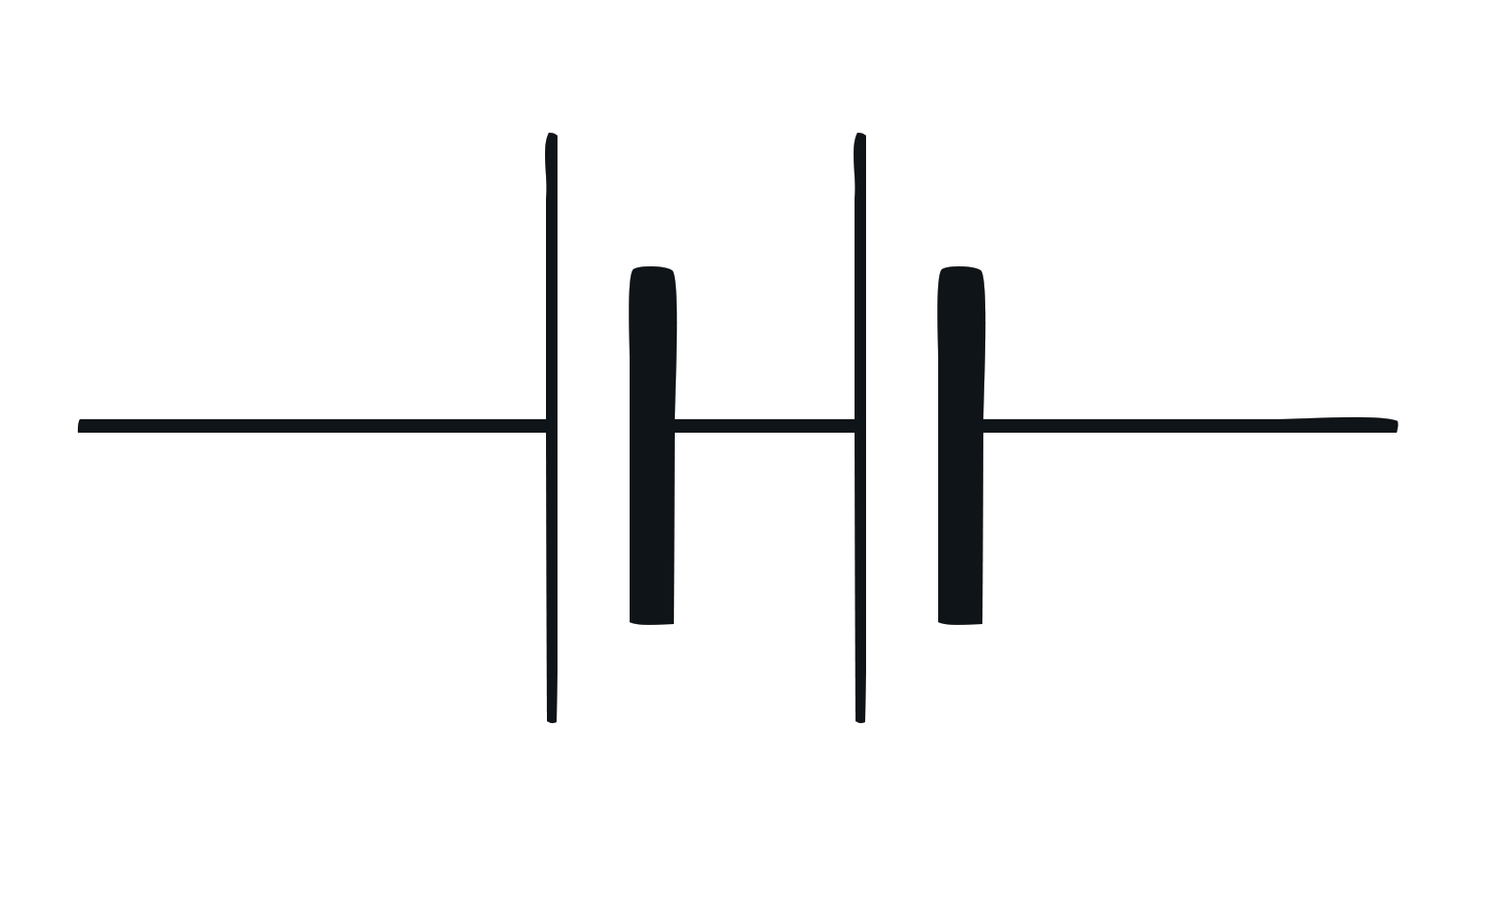


Starter: Identify the Symbol
voltmeter
bulb
open switch
closed switch
battery
ammeter

Slide 4
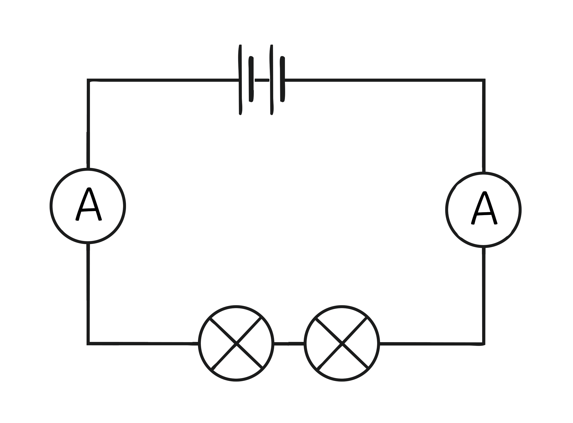
What Is an Electrical Current?
Current is the flow of charge around a circuit. The faster the charge flow, the higher the current.
Current is measured in amps using an ammeter (always in series).
The current is the same everywhere in a series circuit. It does not matter where you put the ammeter, it will give you the same reading.
The current in a series circuit depends upon the number of cells. The more cells you add, the greater the current. Current is not used up.
1.5A
1.5A

Slide 5


Series Circuits: the Rules
When it comes to drawing series circuits, there are certain rules that we must follow every time.
Using the Introduction to Series Circuits Activity
Sheet, you will now have eight minutes to draw
three series circuits using the rules above.
1. Always draw circuits using straight lines.
2. Use a pencil and a ruler to draw these lines.
Start

Slide 6


Ideal Electricals Investigation
Now you have had your basic electrical training, you are now ready to go out to serve the public. Use the Ideal Electricals Investigation Activity Sheet.
What are the variables in this investigation?
Ideal Electricals has employed you as a trainee electrician. Your task is to carry out an investigation to find out the following:
What happens to the brightness of the bulbs in a circuit as you
increase the number of bulbs?
What happens to the current as you increase the number of bulbs in
a circuit?
Independent Variable – what we change.
Dependent Variable – what we measure.
Control Variable – what we keep the same.

Slide 7

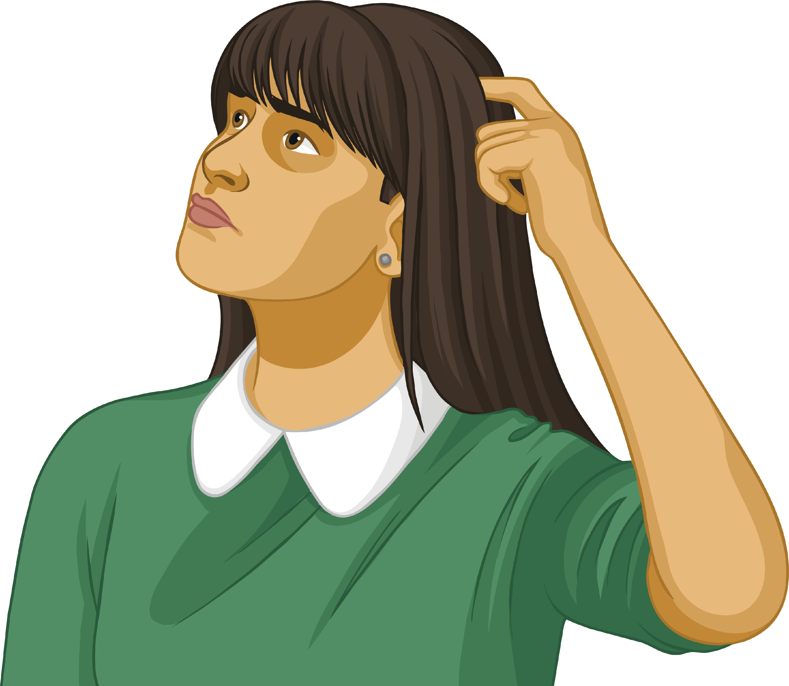
Ideal Electricals Investigation
You will need to build the following circuits:
Circuit 1 - A series circuit with 1 battery, 1 bulb, 1 ammeter.
Circuit 2 - A series circuit with 1 battery, 2 bulbs, 1 ammeter.
Circuit 3 - A series circuit with 1 battery, 3 bulbs, 1 ammeter.
Using the equipment in front of you, can anyone suggest how to build a series circuit?

Slide 8
Ideal Electricals Investigation
In your groups, you will need to collect the following pieces of equipment:
1 battery, 3 bulbs, 1 ammeter, 2 crocodile clips and 5 wires.
Step 1
Collect the equipment.
Place crocodile clips on two of the wires.
Attach the wires with the crocodile clips to each end of the battery.
Using the wire connected to one end of the battery, connect the opposite end of the wire to the ammeter.
Repeat step 4, but this time connect the opposite end of the wire to the bulb.
Connect a wire in between the bulb and ammeter to complete the circuit.
Repeat the steps above for each of the circuits, but add an extra bulb each time.
Step 2
Step 3
Step 4
Step 5
Step 6
Step 7

Slide 9

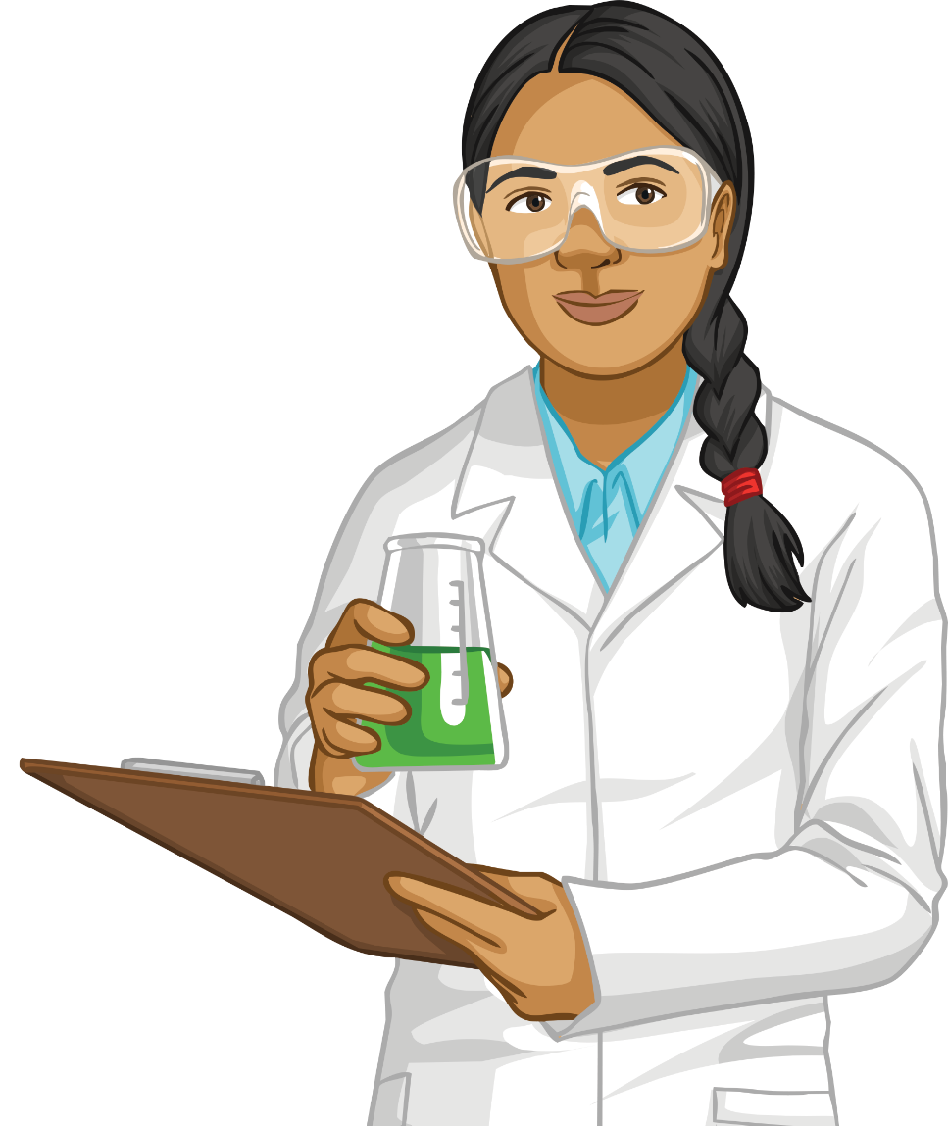
Conclusion
In which circuit were the bulbs the brightest?
Why do you think this is?
Explain what happens to the current as you increase the number of bulbs in a circuit.
Did you find any anomalous results?
How do you know the result(s) were anomalous?
How could we improve the investigation for next time?

Slide 10
Practice Exam Question
Student A has made a steady-hand game. Student A has to move a metal ring along a piece of thick wire until it reaches the rest position.
When Student A is moving the metal ring, it must not touch the wire. If it touches the wire, a buzzer will make a noise.
The metal ring and the thick wire both allow electricity to pass through.
What is the scientific name for materials that allow electricity to flow through them? (1 mark)
Student A covered the rest position with an insulating material. When the metal ring is put down on the rest position, the buzzer cannot work.
Which materials might Student A have used to insulate the wire for the rest position? (2 marks)
copper wire
rubber
plastic
aluminium foil

Slide 11
Extension
A light bulb gets hot when it has been on for some time.
Will a change in temperature have an impact on the flow of charge
around the circuit?
Why do you think this might be the case?

Slide 12
Light Bulb Moment
Today, our success criteria were:
To recall the definition of current and the unit that is used to measure it.
To draw and construct a series circuit from a description.
To explain what happens to the current as the number of bulbs in a circuit is increased.
Complete the sentences with a learning outcome from today.
What Went Well?
I can…
Even Better If:
I need to be able to…

